Slide 1
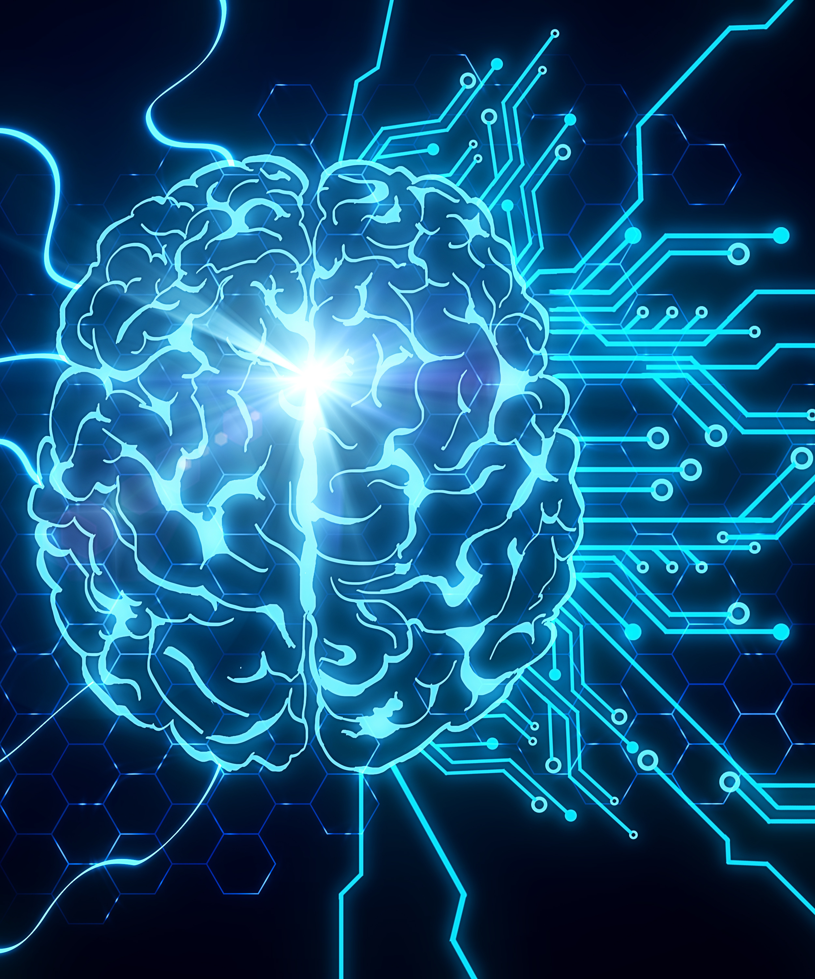
Security Systems Built for Vehicle thefts using Convolutional Neural Network
Eunice Olorunshola
4/20/2022
CSC 8810 Computational Intelligence

Slide 2
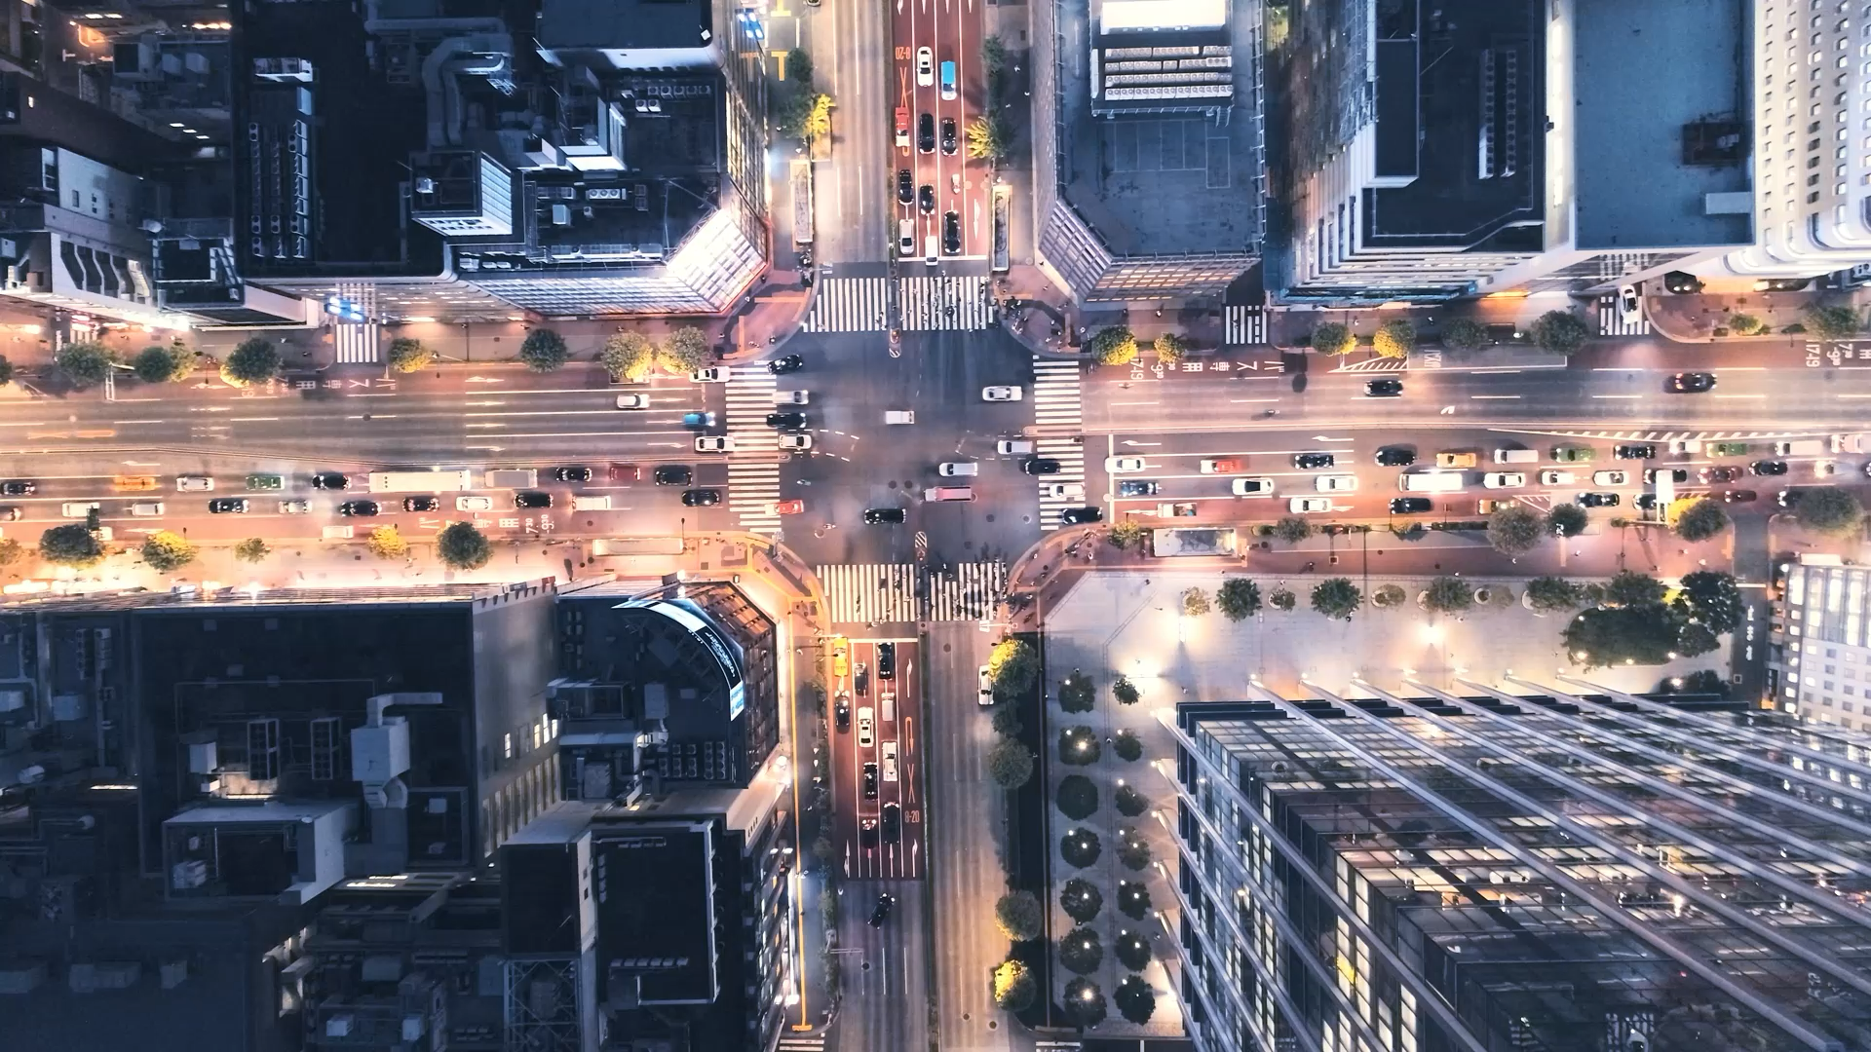
Introduction
Vehicle thefts have always been an issue over the years.
Technology continuously evolving has paved a way to end vehicle thefts by introducing security systems.
Security systems can be seen in parking lots, homes, and public places.
Due to vehicles increasing on the road each day license plate number recognition and face detection has been more effective to end vehicle thefts than static features.

Slide 3

Related Work
License plate number recognition method:
Previous papers have proposed techniques for using ANPRS system (Automatic NUmber Plate Recognition
This system is not much effective because it faces many challenges when it comes to detecting the license plate number
- selective features : font styles, design, colors, shapes, and fast-moving vehicles.
- lighting conditions : reflections, shadows , and blurring.
For my work , proposed techniques VNPR(Vehicle Number Plate Recognition) System will be used to overcome those challenges.

Slide 4
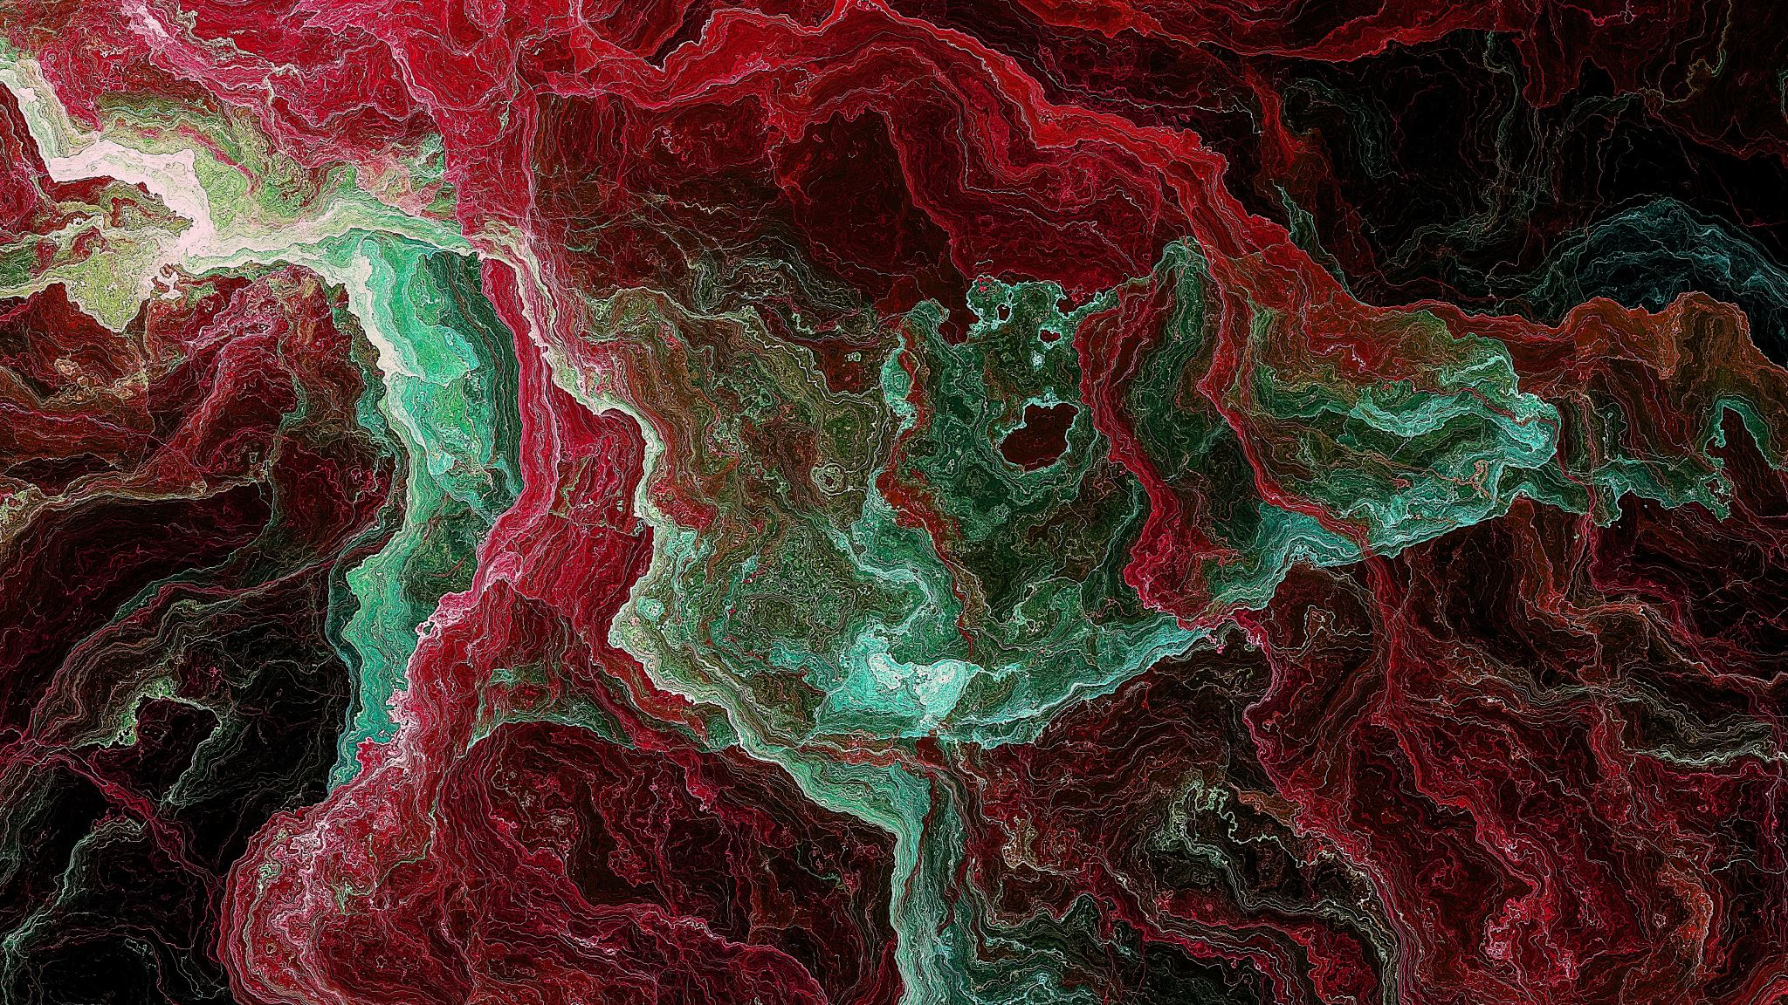
Background

Slide 5

What is VNPR? (Vehicle Number Plate Recognition System)

Slide 6
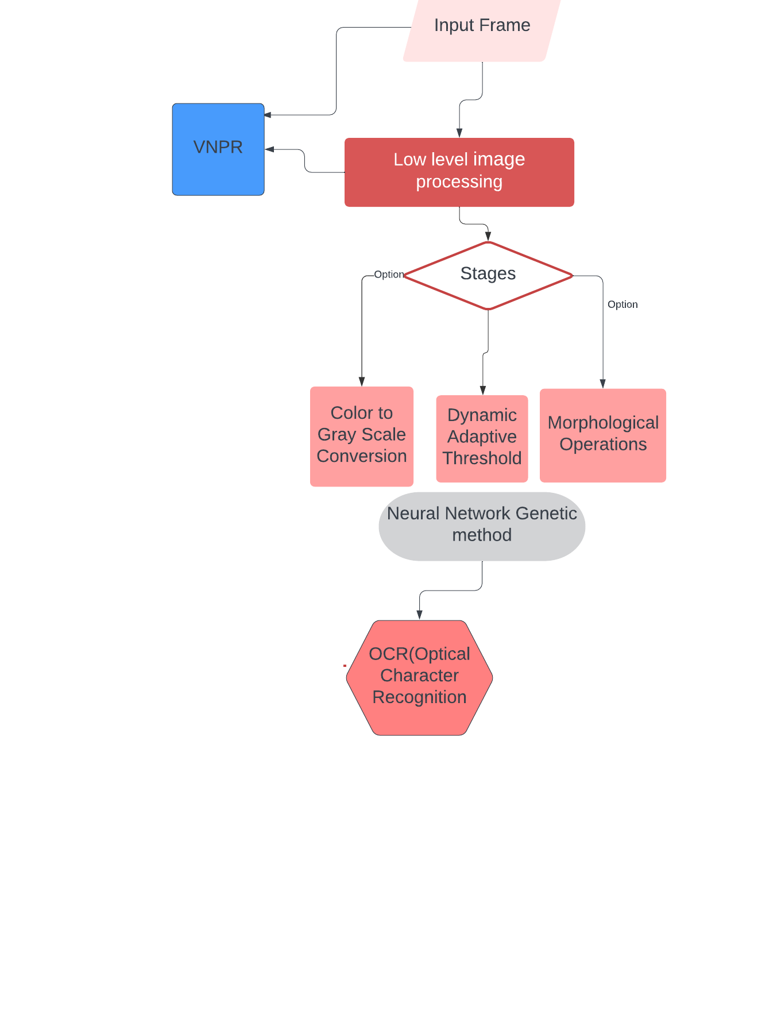
VNPR Flow Chart
First Phase:
Input Frame/Image : Acquire the image of the vehicle with license plate using the Oak – D Lite camera
Low level image processing
- follows 3 stages: Color to Gray Scale Conversion, Dynamic Adaptive Threshold, and Morphological Operations.
Second Phase:
Neural network Genetic method : OCR(Optical Character Recognition ) is used to recognize any character either printed or handwritten in an image after character segmentation and extraction.
The convolutional network layers are used to train the vehicle number plate multiple times to reduce any possible errors in the character identification.
Testing the model is important to achieve accuracy after training.

Slide 7
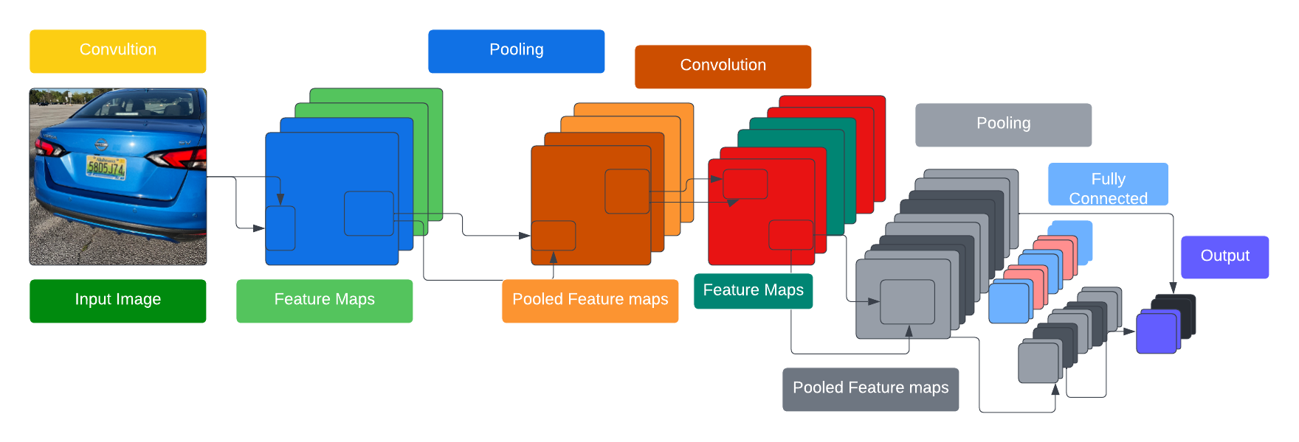
Convolutional Neural Network(CNN) Architecture
Used a CNN with 2 convolution layers at the beginning and 2 fully connected layers at the end.
The CNN has 784 input nodes. The first convolution layer has 5x5 kernels followed by a pooling layer of size 2x2. Output layer has 36 nodes.

Slide 8
Proposed Work

Slide 9
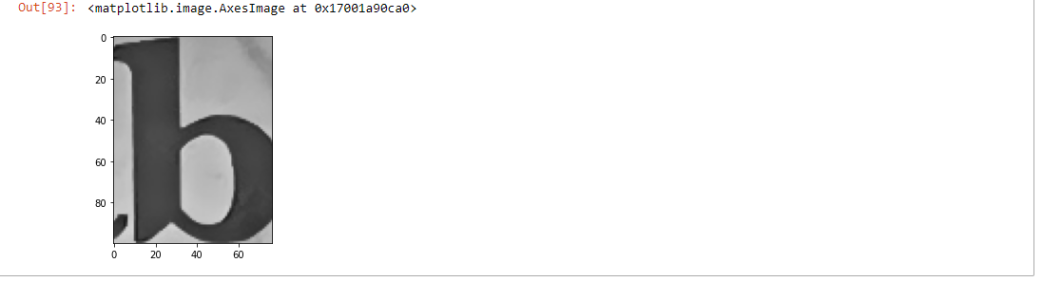
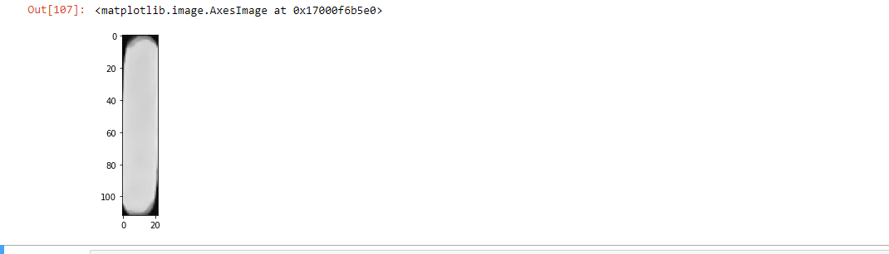
license plate character extraction without image preprocessing

Slide 10

Image Preprocessing Steps:
Preprocessing is an important step to ensure the recognition will be effective and give proper results in later stages.
The main motive of preprocessing is to enhance the quality of the image that will be processed for recognition
The steps follows:
1.RGB to Grayscale conversion : The image inputted is in color , converting it grayscale is needed to reduce the number of colors
2. Noise Reduction : Image noises are distortion in the image that are caused by fault in camera or poor visibility from changing weather conditions.
- Gaussian blur : is used to remove noise by removing the unwanted vertical edges.
3. Binarization : Is the process of converting an image with two pixels value that only contains white and black pixels
Performing binarization before the process of detecting and extracting the license plate from the image will make it easier as the edges will be clearer in the binary image.
This process is performed by selecting a threshold value by using the Otsu method algorithm .
After selecting the threshold value, the plate characters are extracted using Sobel method detection algorithm which helps identify what the shape actually is by detecting the edges.

Slide 11
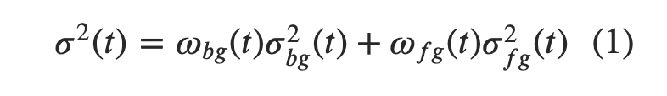
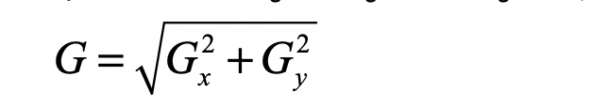
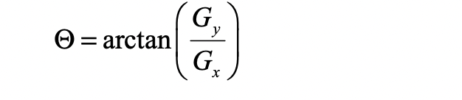
Algorithms Used
Otsu method: is a variance-based technique that is used to find the threshold value where the weighted variance between the foreground and background pixel is the minimum.
Otsu Algorithm iteratively searches for the threshold that is the minimum weighted sum of variances of the two classes (background and foreground)
Formula:
Sobel method detection algorithm : Sobel method uses a Sobel filter for edge detection by calculating the gradient of image intensity at each pixel in the image.
The result shows how the image changes at each pixel , and if the pixel represents an edge
The Sobel filter uses two 3 x 3 kernels , one for changes in the horizontal direction, and one for changes in the vertical direction.
The two kernels are convolved with the original image to calculate the approximations of the derivatives.
Formula:
- Used to calculate gradient direction:

Slide 12
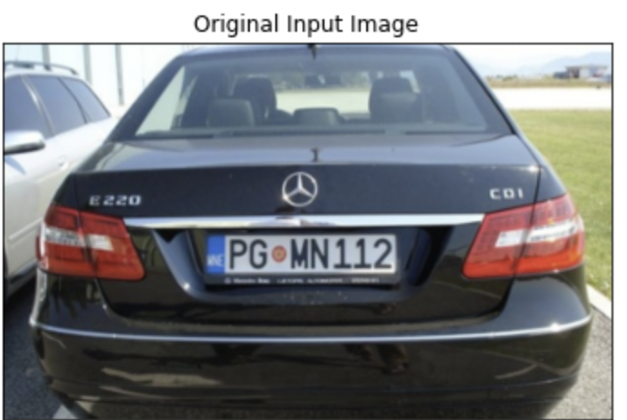
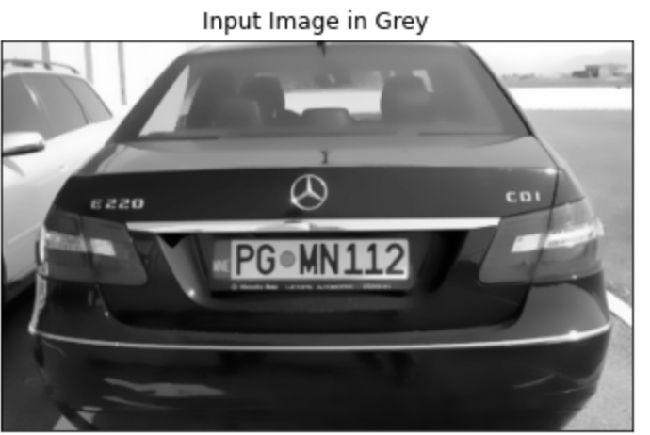
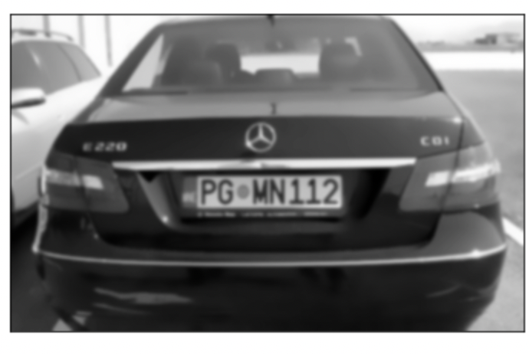
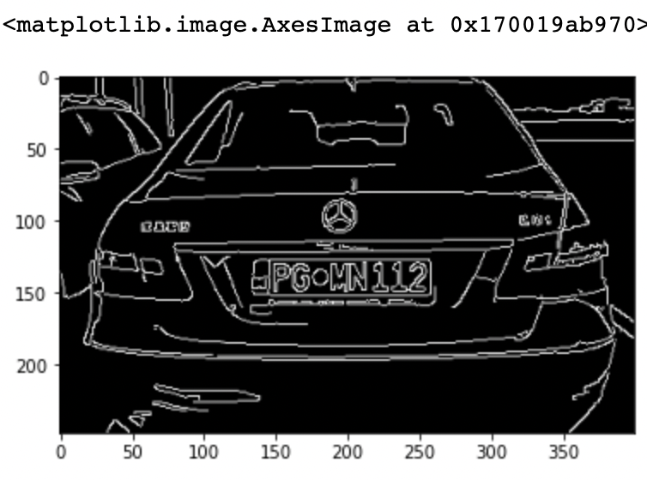
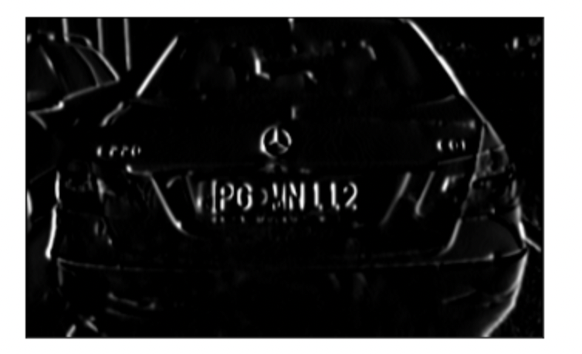
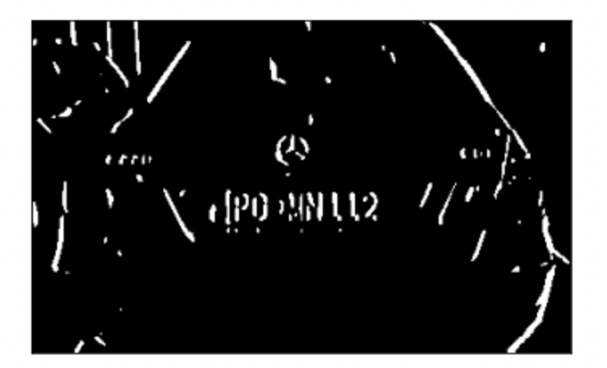
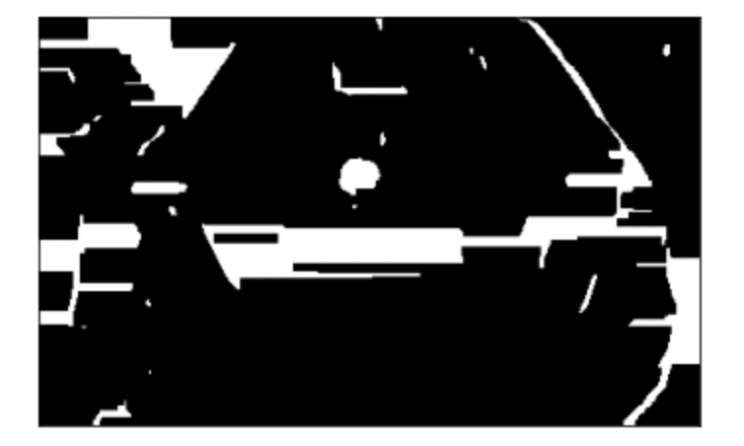
Experiment Implementation
Input Image: Input Image converted to Grayscale: Input Image using Gaussian Blur:
Input Image using Noise Reduction: Input image using Sobel filter: Input Image using Otsu method:
:
Input Image using both methods to detect the shape of the license plate:

Slide 13
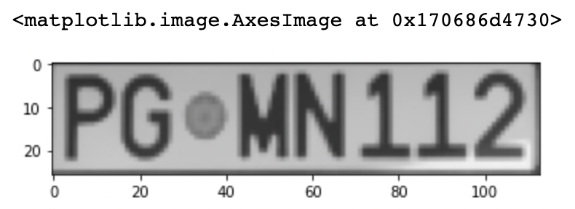
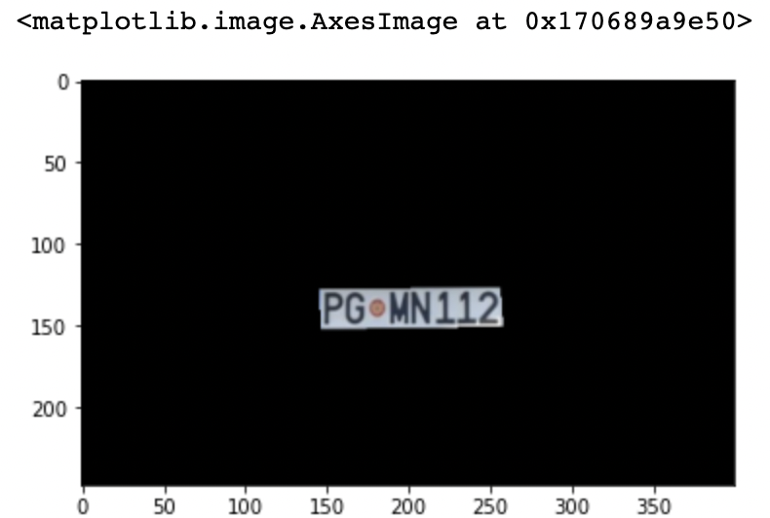
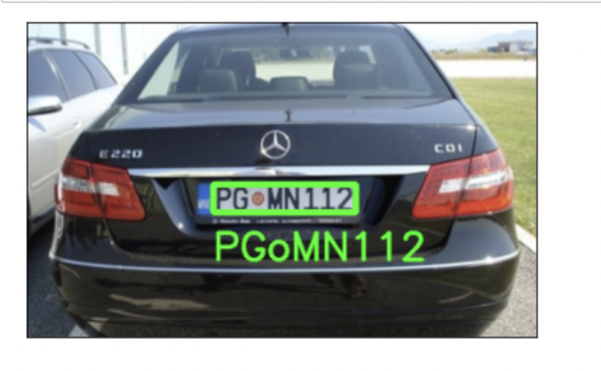
Experiment Implementation Final Result
Result of the license plate character extracted from the input image:
Result of the license plate detected and recognized from the input image:
- Optical Character Recognition(OCR) is
a method in which the input is an image and
the output is a string of characters.
- Separates the different characters from each other in the input image
- - automatically identifies and recognizes the characters from the cropped image.

Slide 14
Face Recognition System
Face Recognition system method is used to recognize and detect the owners of the vehicle by collecting facial images of drivers and using convolutional neural network to extract the features
The approach of the system is to follow my proposed framework of acquiring the image of the vehicle owner in the vehicle, face detection, face extraction , and feature extractor.
- Follows two stages : input the constructed images and output the final facial images and mark the position of the feature points of the face, eyes, nose, and every corner of the mouth.

Slide 15
Methods Used
Neural network-based method :
- CNN allowed automatically extracting the feature vectors that capture the variability of data without any interference done by hand.
Model based methods: Was used to reconstruct a model of the face that capture facial variations.
Obtains the relative position features from the placement of the facial elements: eyes, nose, and every corner of the mouth.
Deep learning method :
- CNN uses a cascade of multiple layers of processing for feature extraction and transformation.

Slide 16

Image Pre-Processing Steps:
The input image is processed using three methods:
- image resizing : the image size is decreased to a lower resolution for faster processing
- mean subtraction and scaling : The image is normalized using mean subtraction and scaling .

Slide 17
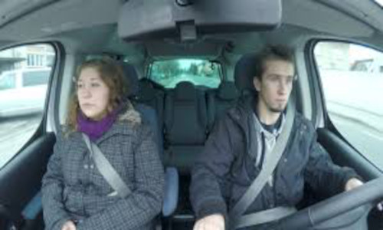
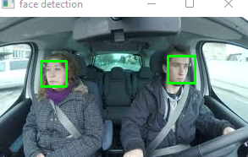
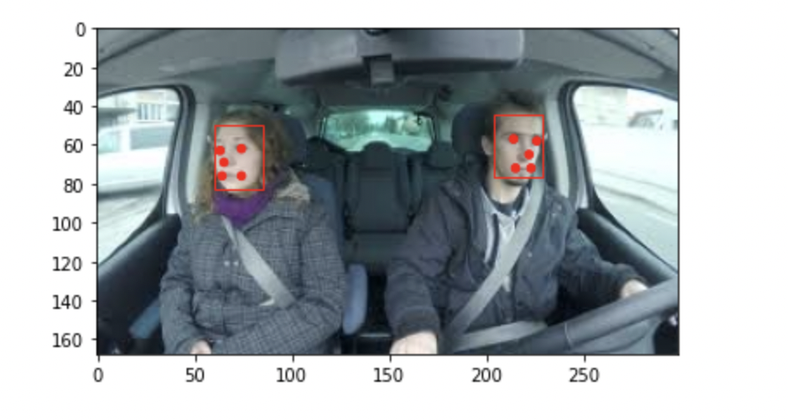
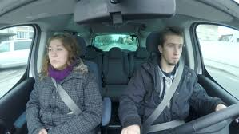
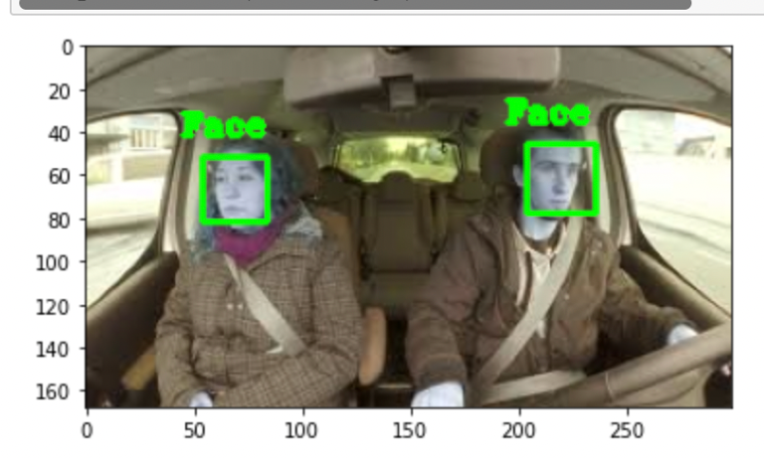
Experiment Implementation
Input image Resized Face Detection Face Extractor
Object detection for face recognition and detection

Slide 18


Experiment Implementation Results
The bounding box in a shape as a rectangle is used to detect the face.
Each bounding box lists the x and y coordinates for the bottom left-hand corner of the bounding box, as well as the width and height.
-
The results shown above show that the two bounding boxes were detected.
Mutlitask CNN library was used to create the detector , the results shown below loads the photograph, loads the model, performs face detection and prints a list of each face detected from the five feature points

Slide 19



Software/Tools Used
Juypter Notebook
Code in Python
Installed libraries : open cv, imutils, and pytesseract.

Slide 20
Conclusion
With the rise in vehicle thefts, there is a need to focus on enhancing the security of vehicles at public places, and parking lots. In this paper, I proposed to implement an VNPR and Face Recognition System which will capture and recognize images of a vehicle and has a good scope for future to increase security level.
VNPR is implemented using many different algorithms and techniques
My proposed methodology initially does the pre-preprocessing steps which includes RGB to gray scale conversion, noise reduction , and binarization.
The vehicle plate is extracted using Sobel’s edge detection algorithms. Then the characters are segmented which is given as input to the CNN in order to recognize the character correctly.
Face detection can be applied in a lot of the different places such as security systems in order to enhance the security and to track certain people or objects.
The facial detection algorithm tries to localize the faces and then extract each of the faces present in the input.

Slide 21
Future Work
VNPR System:
Using the system to recognize car model with datasets
Fancy character recognition
Multi-lingual recognition
Face Recognition System :
Acquire large datasets to improve the accuracy of the algorithm
Detect faces through security systems datasets.
Train the model with more steps

